Slide 1
Tier III Passenger Equipment
Regulatory requirements for the next generation of HSR equipment
September 15, 2016 – Washington, DC
Devin C. Rouse, PE
Program Manager – Passenger Equipment Compliance and Regulations
Office of Railroad Safety
Federal Railroad Administration, USDOT

Slide 2
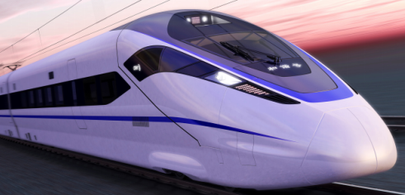
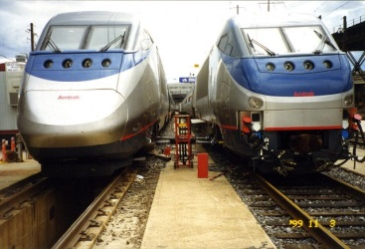
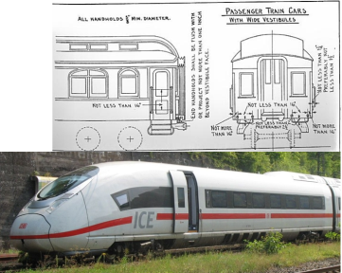
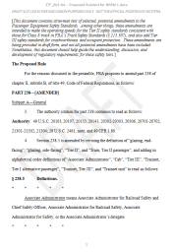
This presentation will provide insight into the developing regulations for Tier III HSR trainsets
What is Tier III?
Description of the Tier III Regulatory Approach
Regulations that make up Tier III (regulatory framework)
Current Resources and Working Documents

Slide 3
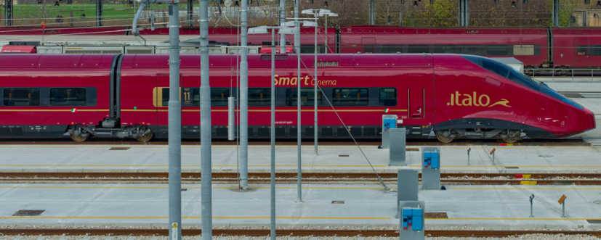
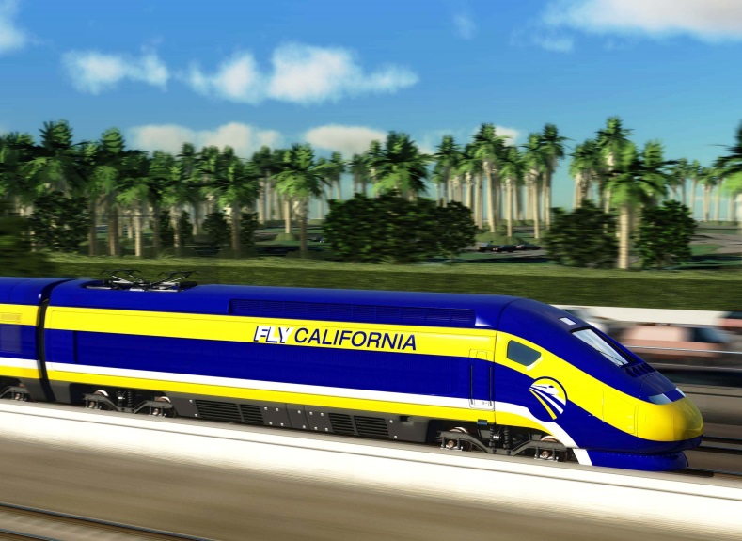
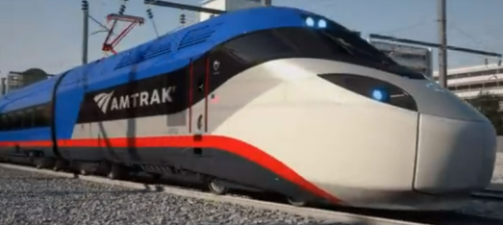
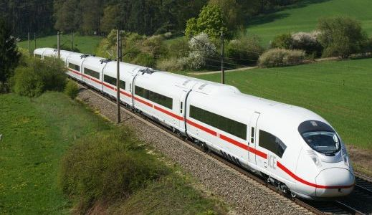

What is “Tier III?”
Tier III defines the requirements for next generation very high-speed trainsets
Key features are:
  Allows maximum authorized speeds of up to 220mph
  Provides complete interoperability with conventional passenger & freight operations up to 125mph*
  Designed to harmonizes with “service proven” international standards and design methodologies
  Follows on the inspection and maintenance regime established with Tier II (Acela)
*Amtrak has applied for a conditional waiver to allow for interoperable operations up to Class 8 limits (i.e. Acela)

Slide 4
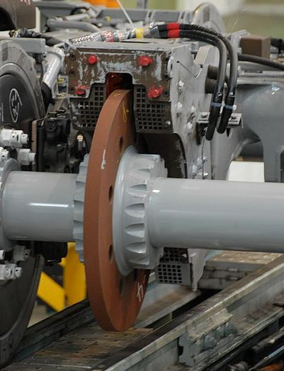
Tier III regulatory approach
Guiding principle: conceive performance-based regulations which accommodate existing service-proven designs
Approach:
Systematic – consider safety from a “system” perspective
Technology Neutral – recognize that some metrics must be defined by the system and technology implemented, not prescribed
Rotary eddy current brake (courtesy of Wikipedia)

Slide 5
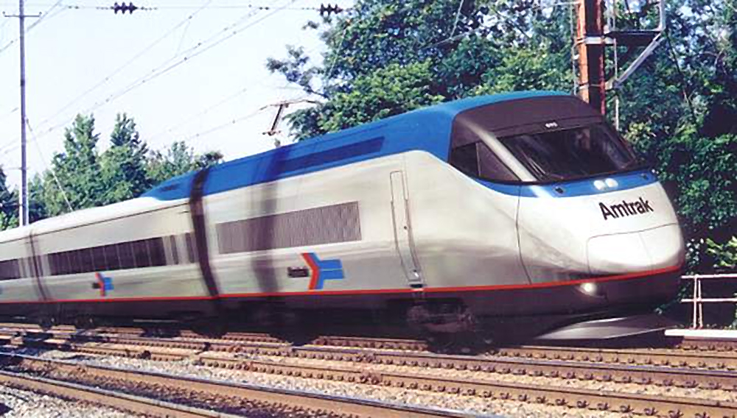
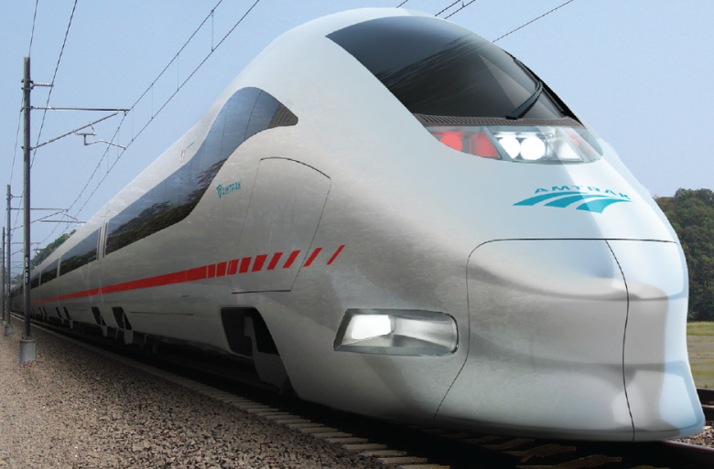
Tier III regulatory approach
Develop appropriate counterpart sections to Tier II Subparts E(Specific Requirements), F (ITM) & G (Safety Planning)
  Tier II language will be used as basis
Outline the minimum performance thresholds or plan content, but do not prescribe how they are to be achieved
Incorporate “lessons learned” from Tier II, particularly with respect to process efficiency

Slide 6
Regulations that make up Tier III requirements
Trainset Structure/Crashworthiness
Interior Attachments
Glazing
Brake System
Emergency Systems/Lighting
Safety appliances
General Safety (part 229)
  Cab Conditions – noise, general conditions, sanitation
  Cab Equipment – alerters, event recorders, cab lights
  Exterior Appurtenances – headlights, aux lights, marker lights
  Electrical systems – current collectors, circuit protection, insulations, treatment of high voltage, conductors, motors/generators, energy storage, power dissipation, EMI/EMC, etc.
Trainset Electronics
Compliance testing and start-up procedures
Inspection Testing Maintenance
Safe Operating Plan
NPRM 1
NPRM 2

Slide 7
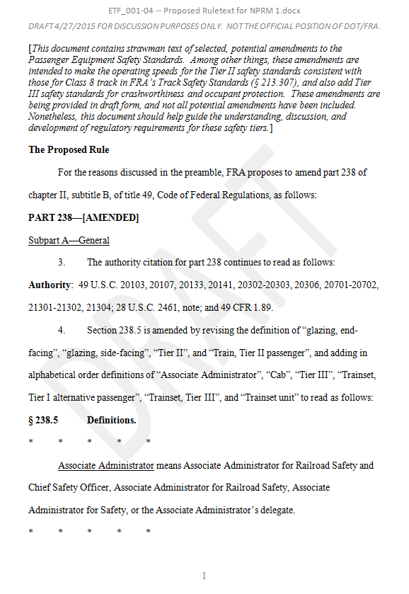
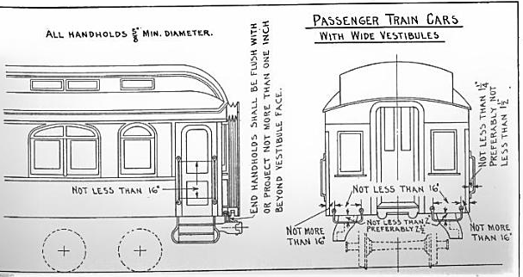
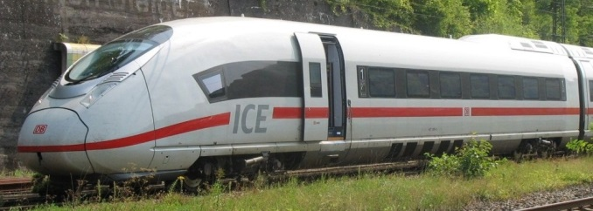
Current resources and working documents – NPRM 1
Draft ruletext provided in:
“ETF_001-04 – Proposed Ruletext for NPRM 1”
Courtesy of Oran Safety Glass

Slide 8
Current resources and working documents – NPRM 2
Status | Topic | ETF Document #
Previously Approved Proposals | Safety Appliances | ETF_070-02 -- Proposed Ruletext for NPRM 2
 | Electrical Systems
 | Cab Equipment (event recorder, alerters)
 | Cab Conditions (except noise)
 | Exterior Appurtenances (headlights, aux/marker lights)
 | Inspection Testing & Maintenance (ITM)
Recently Approved Proposals | Cab Conditions (Noise) | ETF_069-01
 | Electronic Hardware/Software Safety | ETF-060-03
 | Cab Equipment (speed indicator) | ETF_068-01
 | Tier III Inspection Records and Recordkeeping (Blue Card, etc.) | ETF_061-01
Pending Proposals | Trucks and Suspension Systems | ETF-229+ITM_011-04
 | Tier III Safe Operation Plan | ETF_040-04

Slide 9
FRA Tier III Contacts
Technical Questions:
Devin Rouse
Chair – Engineering Task Force
Federal Railroad Administration
(202) 493-6185
devin.rouse@dot.gov
or
Fred Mottley
Program Manager - HSR
Federal Railroad Administration
(617) 494-3160
Fred.Mottley@dot.gov
Legal Questions:
Michael Hunter
Trial Attorney
Federal Railroad Administration
(202) 493-0368
michael.hunter@dot.gov
Questions?

