Slide 1




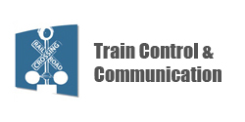
PTC Implementation RSAC Update
Devin Rouse, P.E.
Program Manager / PTC Task For Lead
FRA Office of Railroad Safety
September 15, 2016

Slide 2
Outline
Changes implemented in 2016
Industry Progress
Updates on PTC grants
Upcoming changes to FRA website and information availability
Areas of focus for FRA

Slide 3
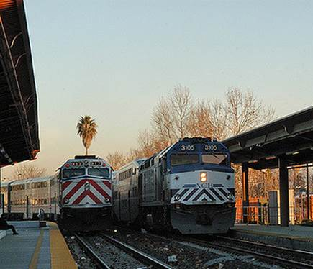
New for 2016
  New railroad PTCIP’s filed in January:
  FRA review complete – response letters being processed
  Requests for Amendment – being addressed separately, as needed
  Regulations updated to include changes from PTC Extension and FAST Act
  New standardized annual and quarterly PTC progress reports implemented
  Monthly reporting eliminated

Slide 4
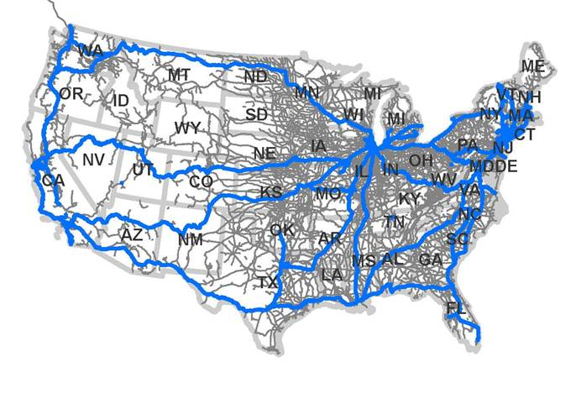
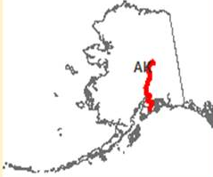
PTC Railroads and Nationwide Implementation
41 Active Railroads are currently implementing PTC
  7 Class I Freight Railroads
  28 Passenger/Commuter Railroads (Including Amtrak)
  6 Regional/Shortline and Terminal Railroads
    Excludes tenant railroads required to implement by hosts
4 “New Start” railroads are currently developing systems
  Denver-RTD (currently testing)
  SMART (currently testing)
  AAF/FEC (est. 2017)
  TexRail (development)
Source: 2013 FRA data – Passenger PTC routes ONLY – does not include other traffic types
Notes:
(possibly include a Map – talk to Tom Bouve);

Slide 5
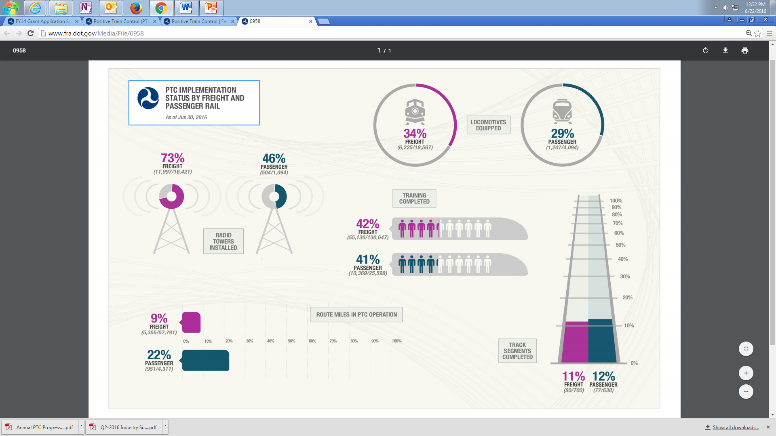
Industry Progress Highlights
  Wayside equipment has been installed on over 11% of track segments
  Over 32% of locomotives are fully equipped with PTC hardware
  ~ 71% of radio towers are installed
  note: not all systems require radio towers
  To date, ~ 6,306 route miles are in PTC operation

Slide 6
Status of major systems currently under development
Railroad | System | Type | Status | Safety Plans Filed
BNSF, CSX, SCRRA, CP, UP | IETMS | Non-Vital Overlay | Certified | 5
BNSF, UP, CSX, NS, CN, CP, KCS, & Most non-NEC Passenger | IETMS | Vital* Overlay | Development | 0
NEC Carriers (except NS, MARC, Conrail | ACSES /Cab Signals | Vital Overlay | Certified | 1 (SEPTA)
AMTRAK (Michigan) | ITCS | Vital Overlay | Approved | -
PATH | CBTC | Vital Stand Alone | Development | 1
CALTRAIN, New Mexico Rail Runner | IETMS/ITCS Combined | Vital Overlay | Development | 0
Tri-Met/P&W, SMART, AAF/FEC, UTA, DCTA, CMTA | EATC | Vital Overlay | Development | 0
GPS antenna (top), ACSES transponder (bottom)
*Note: Some carriers may elect to implement a non-vital version of IETMS

Slide 7
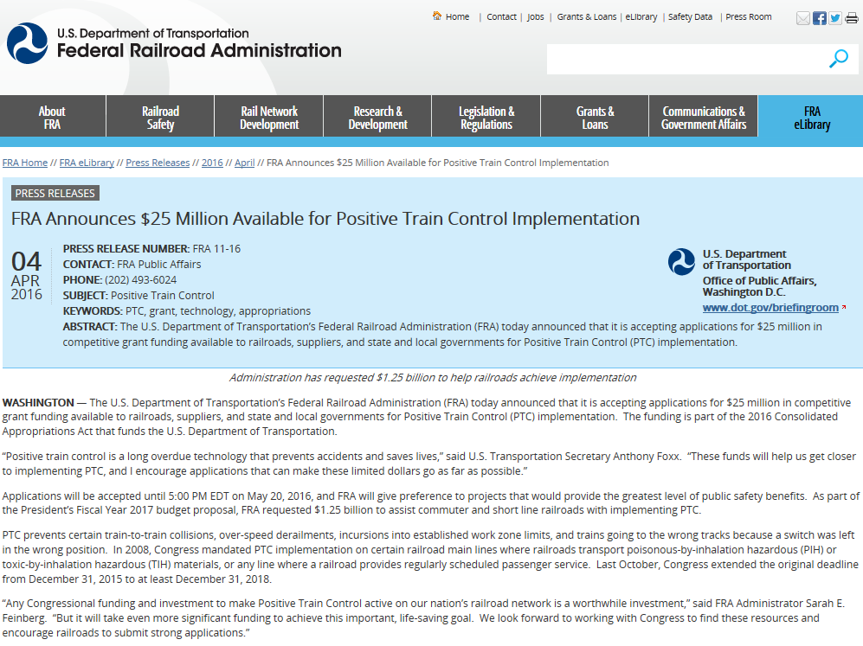
PTC Grants
  2 (of 4) FY 2014 FRA Railroad Technology (PTC) Grants currently being executed
  11 FY 2016 FRA Railroad Technology-PTC Grants awarded in August
  FY 2017 FTA eligible Passenger Rail PTC Grant Applications
  – DUE Sept. 27 by 5pm (EST)
  FR-TEC-16-002

Slide 8
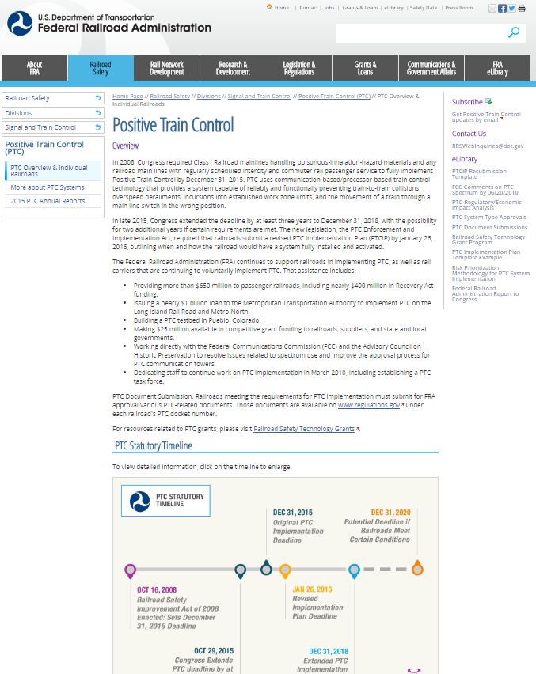
Upcoming changes to enhance FRA PTC website utility and information availability
Improved connections and links to pertinent documents and information
  Type Approvals
  Forms/Templates/Example Documents
  Railroad dockets
  Grant information
Railroad-by-railroad Information:
  Annual/quarterly reports
  Synopsis of reported progress
Improved and increased guidance information regarding submissions to FRA

Slide 9
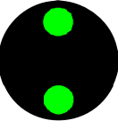
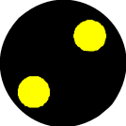
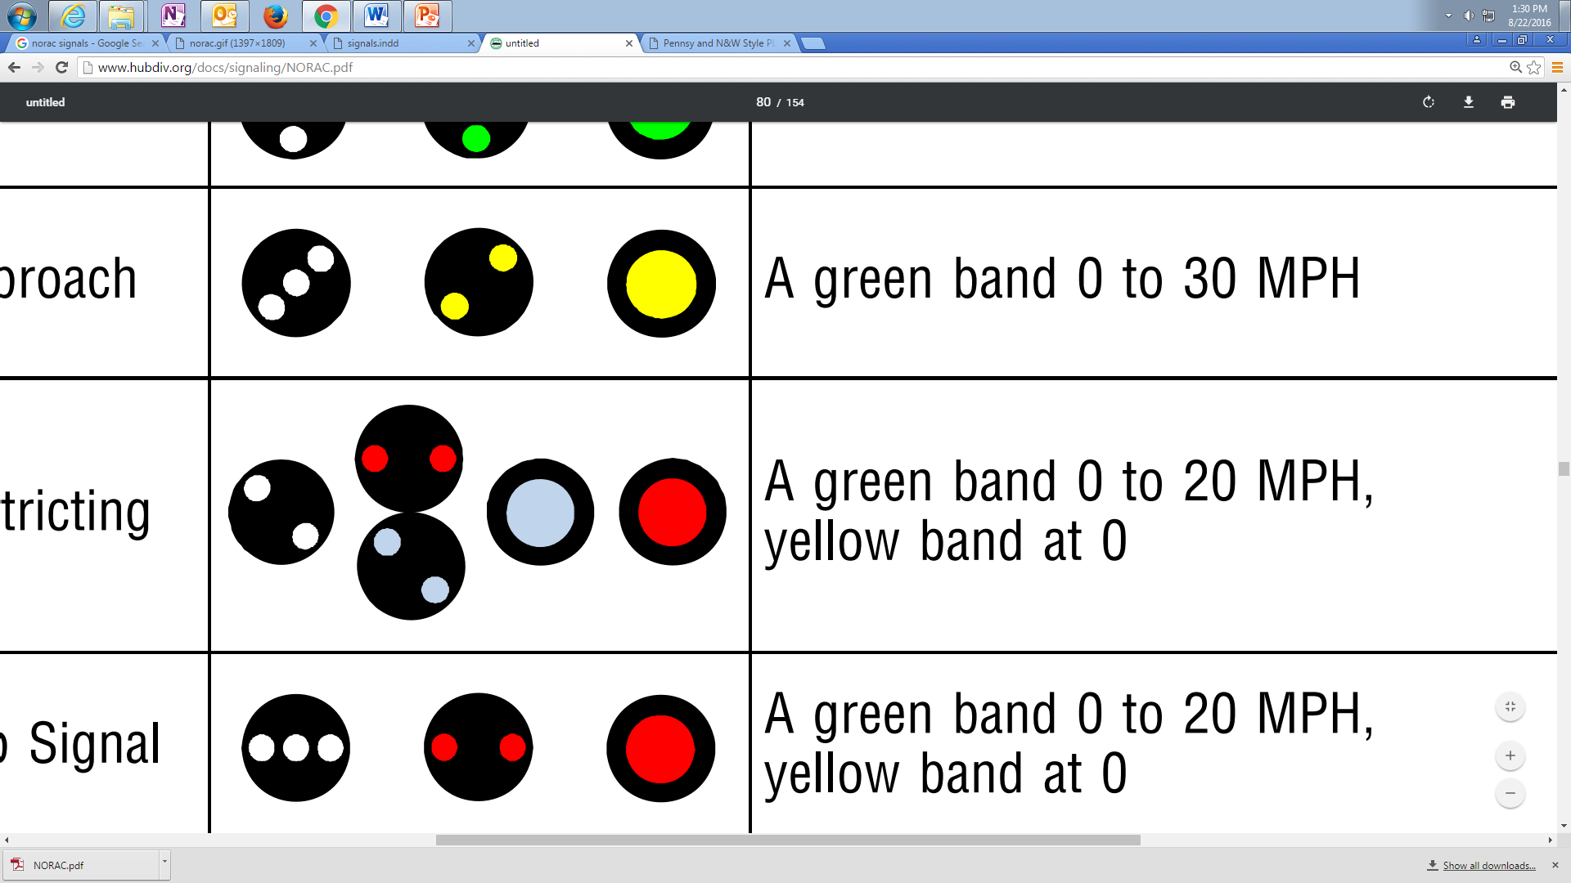
Particular areas of focus for FRA in the near term
Standardization of procedures and reporting where practical (e.g. progress reports)
Updating and refreshing the FRA PTC websites to make information more accessible
PTC Test Monitoring:
Maximizing efficiencies in test plan review/approvals
Reducing administrative burden to allow test monitors to focus on monitoring and working with railroads
Safety Plan (PTCSP) Review/Certification:
Providing additional guidance to industry based on “lessons learned” from early implementers
Work with industry to refine templates and develop tools to enhance submission focus/quality
Complete
In Progress
Started
Pending

Slide 10
FRA Contacts
General Questions:
Devin Rouse
Project Manager
Office of Railroad Safety
Federal Railroad Administration
(202) 493-6185
devin.rouse@dot.gov
Technical Questions:
Mark Hartong
Senior Scientific Technical Advisor
Federal Railroad Administration
(202) 493-1332
mark.hartong@dot.gov
or
David Blackmore
Staff Director, Positive Train Control
Federal Railroad Administration
(312) 835-3903
david.blackmore@dot.gov

