Slide 1
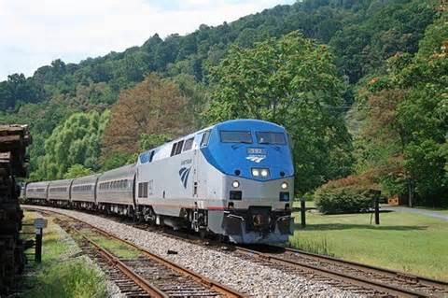

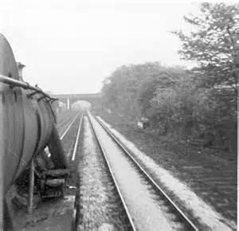
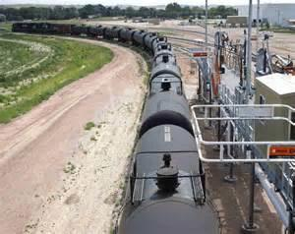
Office of Railroad Safety
Presentation
Passenger Rail Division
System Safety Final Rule
49CFR270 Report
September 15, 2016

Slide 2
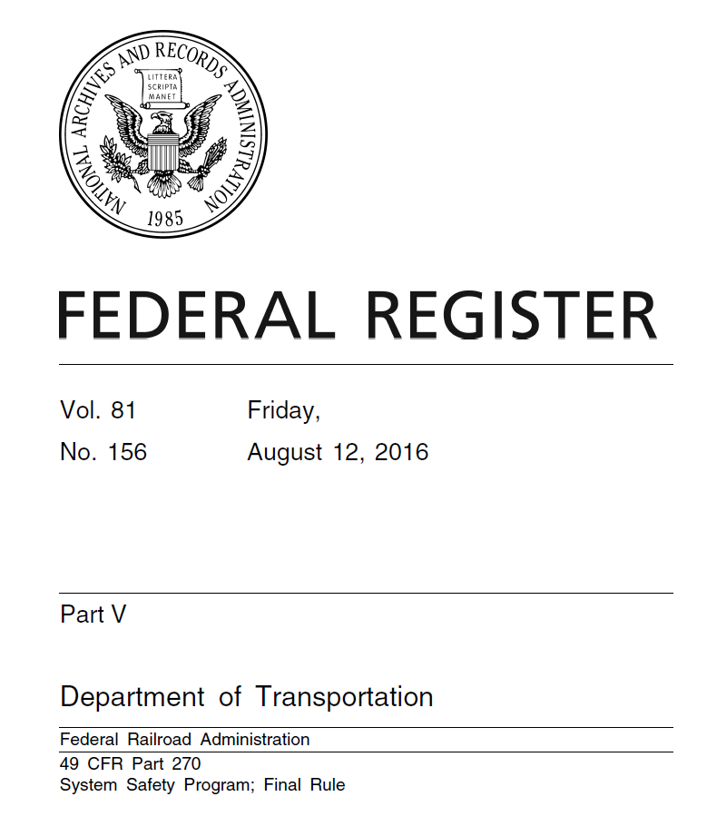
System Safety Program (SSP) Rule
Agenda
Published as 49 CFR Part270
  August 12, 2016
Effective – October 10, 2016

Slide 3
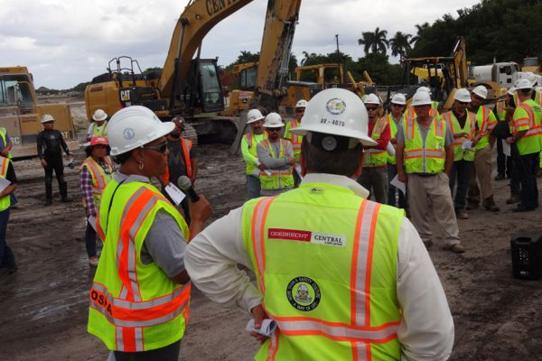
Approach to Safety
SSP is not prescriptive, it is a more process driven approach:
Proactive
Systematic
Actively promoting continuous safety improvement
Directly affecting safety culture

Slide 4
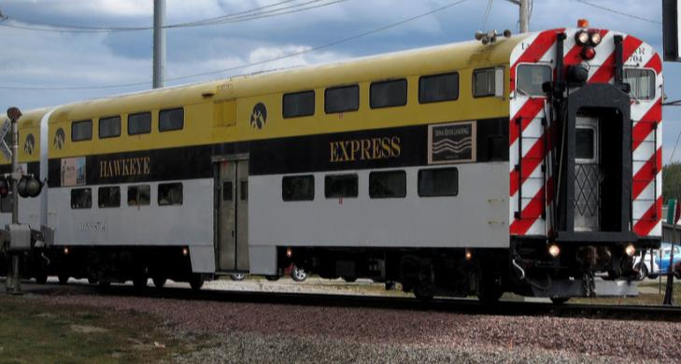
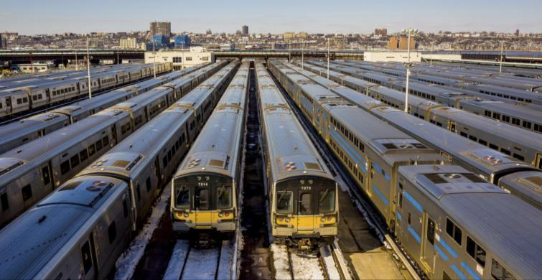
Flexible
https://c1.staticflickr.com/7/6154/6187501937_6fdc7056a1_b.jpg
The rule provides each railroad with flexibility to tailor its SSP to its specific operations.

Slide 5
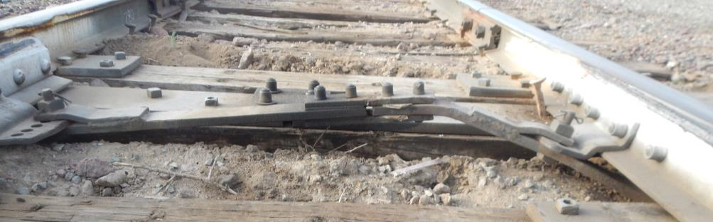
Promotes Safety Culture
SSP encourages a railroad and its employees to work together to proactively identify hazards and to jointly determine what, if any, action to take to mitigate or eliminate the resulting risks.

Slide 6

Key Dates
Rule Effective Date
  October 10, 2016
Initial Consultation Meeting with Directly Affected Employees
  No later than April 10, 2017
  Notice of Preliminary Meeting at least 60 days before meeting
Plan Submission
  No later than February 8, 2018

Slide 7
Consultation with Employees/Labor
270.107 Consultation Requirements
Each railroad required to establish an SSP shall in good faith consult with, and use its best efforts to reach agreement with, all of its directly affected employees, including any non-profit labor organization representing a class or craft of directly affected employees, on the contents of the SSP plan.

Slide 8
Consultation with Employees/Labor
Appendix B to Part 270 – FRA Guidance on the System Safety Program Plan Consultation Process
Meaning of “good faith” and “best efforts”
Guidance on how a railroad may consult with directly affected employees

Slide 9
Information Protections
270.105: Certain information a railroad compiles or collects for the SSP is protected from discovery, admission into evidence, or use for any other purpose in a Federal or State Court proceeding for damages involving personal injury, wrongful death, or property damage. Generally:
Information is compiled or collected solely for SSP
Not required by another law or regulation
Non-SSP use of the information is unprotected
If information was not protected prior to SSP rule, it remains unprotected

Slide 10
Information Protections - FOIA
49 U.S.C. 20118 (RSIA) specifies that certain risk reduction records (including SSP records) obtained by FRA are exempt from the public disclosure requirements of the Freedom of Information Act (FOIA).
Two exceptions to this exemption:
  Disclosure is necessary to enforce or carry out any Federal law, or
  Disclosure is permitted when a record is comprised of facts otherwise available to the public and FRA has determined that disclosure would be consistent with the confidentiality needed for SSPs.
Unless one of the two exceptions provided by section 20118 would apply, FRA would withhold disclosing any such records in response to a FOIA request. See 5 U.S.C. 552(b)(3) and 49 CFR 7.23(c)(3).

Slide 11
FRA System Safety Program Plan
Contents (Elements) Final Rule Part 270
Program Policy Statement
Program Goals
Railroad System Description
Railroad Management and Organizational Structure
Program Implementation Process
Maintenance, Repair & Inspection Program
Rules Compliance & Procedures Review
Employee/Contractor Training
Emergency Management
Workplace Safety
Public Safety Outreach
Accident/Incident Reporting & Investigation
Safety Data Acquisition
Contract Procurement Requirements
Risk-Based Hazard Management
Risk-Based Hazard Analysis
Technology Analysis & Implementation Plan
Safety Assurance
  Change Management
  Configuration Management
  Safety Certification
Safety Culture

Slide 12


Vs.
FRA 21 Elements
  Similar elements
  Stronger Emphasis on
  Risk Based Hazard Management
  Analysis
APTA 23 Elements
Similar elements
Not Included in 270
  Loss Prevention and Control
  Security

Slide 13
Roll Out of Regulation
Implementation guide
Process for electronic plan submittal
Consistent process for FRA reviewing plans
Internal audit process review
External audits (focused and full)
Training and outreach
Hire Staff

Slide 14
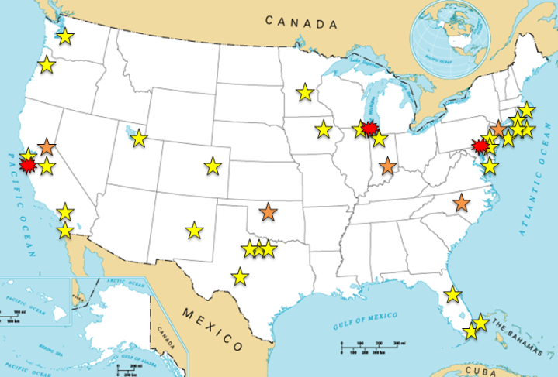
Information/Outreach Sessions
FRA plans to hold sessions in Northeast, Midwest and West Coast.
Coordinate with APTA for on-line sessions.
FRA will also release guides and provide FAQ sheets for outstanding issues.

Slide 15
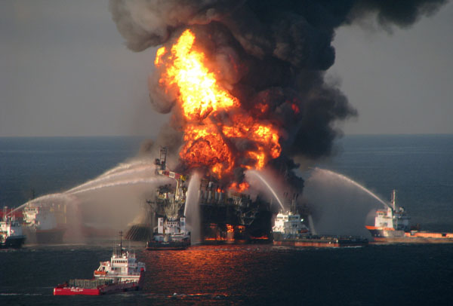
Sample Elements and Expectations
Safety Culture
You have a culture
Is it positive or negative
How do you monitor?
Is there un-filtered communication going both directions
  Top to bottom
  Bottom to Top

Slide 16
Sample Elements and Expectations
Program Policy Statement
Define the railroad’s authority for establishment and implementation of SSP.
Describe the safety philosophy and safety culture.
Program Goals
Long-term, meaningful, measurable and focused on identification of hazards and mitigation.

Slide 17
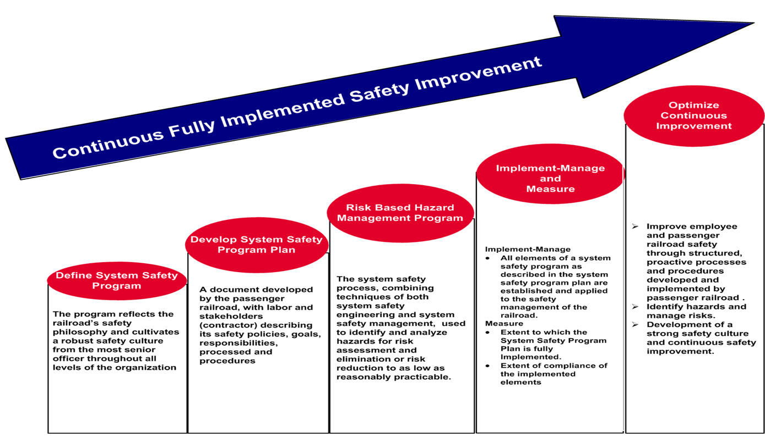

Implementation

Slide 18

Sample Elements and Expectations
Hazard Management
Responsibility for administering the risk- based hazard management program
Participants in hazard management teams
Identifying /analyze hazards/rank
Mitigate or eliminate hazards and corresponding risks
Continuous safety improvement throughout the life of the rail system

Slide 19

Questions

