Slide 1
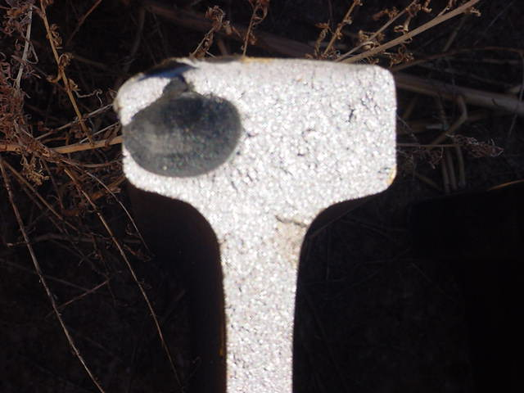
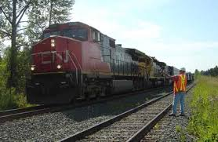
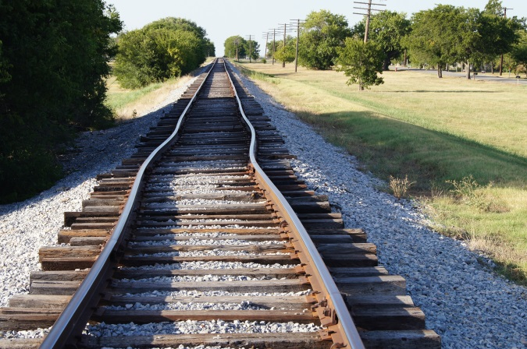
Rail Integrity Working Group Meeting
September 15, 2016
Washington, DC

Slide 2
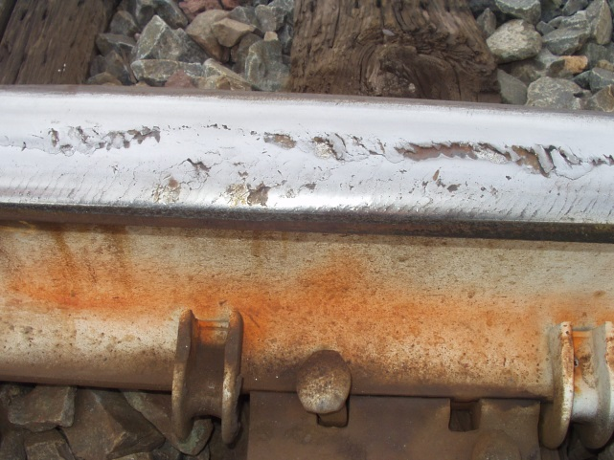
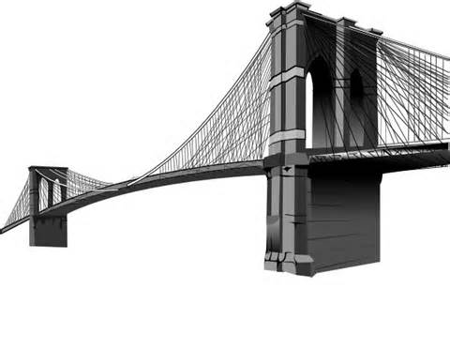
RAIL INTEGRITY WORKING GROUP
Task 15-03
Purpose: To consider specific improvements to the Track Safety Standards Subpart A-G designed to enhance rail safety by improving rail defect remedial actions and by requiring internal rail inspection on Class 2 track.
Notes:
July 20 meeting presentation to working group

Slide 3
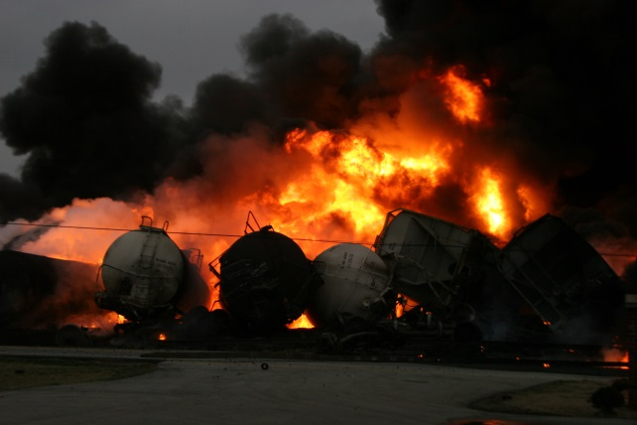
RAIL INTEGRITY WORKING GROUP
Title 49 CFR Part 213.113, Defective rails.
Review, investigate, discuss, and consider adopting more restrictive remedial actions for defective rails, such as lowering the maximum operating speed allowed over the defective rail until repaired, and shortening timeframes for repair or replacement of the defective rail.

Slide 4
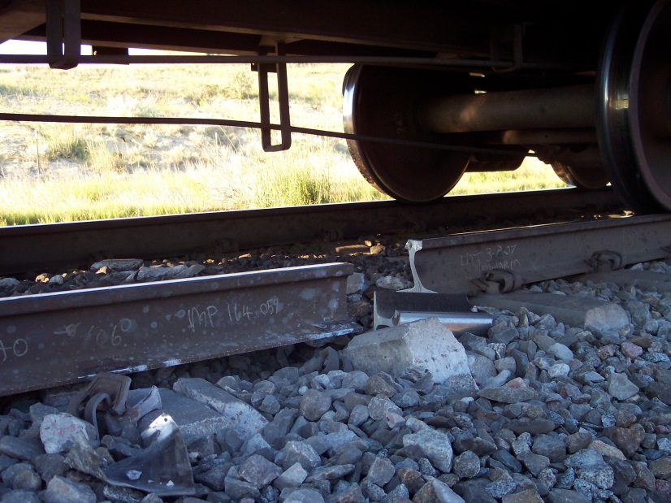
RAIL INTEGRITY WORKING GROUP
Title 49 CFR Part 213.241, Inspection records.
Review, investigate, and discuss regulatory language that would require railroads to provide rail defect and failure information to FRA when verifying compliance with the performance-based inspection frequencies.
Notes:
Data Collection Task Force Committee meeting via teleconference on data masking via second party collection. TTCI to produce a generic document from RR submitted forms. Aug meeting teleconferance.

Slide 5
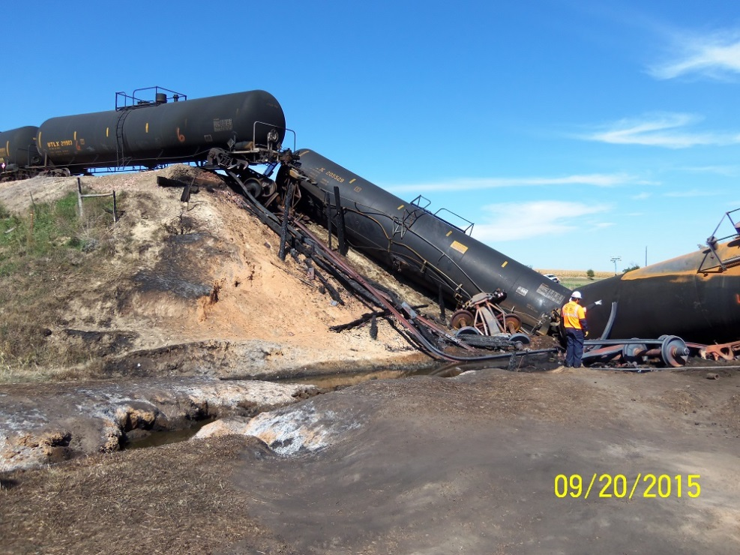
RAIL INTEGRITY WORKING GROUP
Title 49 CFR Part 213.237, Inspection of rail.
Review, investigate, discuss, and consider updates to require rail inspection on Class 2 track based on tonnage and type of traffic over the track.
Notes:
Discussion July 20 meeting on class 2 inspections on presentation

Slide 6
RAIL INTEGRITY WORKING GROUP
July 20 meeting
Rail wear regulations proposed with discussion on automated geo car inspection
Discussion on class two track with hazmat, rail inspection and updated regulations.
Discussion on rail wear tables from working group

Slide 7
RAIL INTEGRITY WORKING GROUP
Meetings to Date and Proposed
November 19, 2015 Kick Off Meeting
February 23 & 24 Meeting
July 20, 2016
August 25, 2016 Teleconference Data Analysis Task Force
Proposed September 19, 2016 Data Task Force Teleconference
Notes:
August 25,Agreeded to have TTCI look at railroad broken rail forms to come up with a generic form by Sept 19, 2016 Teleconference

Slide 8
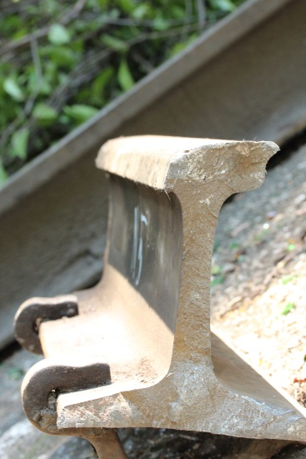
RAIL INTEGRITY WORKING GROUP
Accomplishments
Established Data Collection & Analysis Task Force.
Working Group discussion on FRA rail head wear regulations proposal
Discussion on class 2 rail testing
Submission by AAR rail wear regulations
Notes:
July 20 meeting rebuttal response from railroads on rail wear regulations of two new tables.

Slide 9
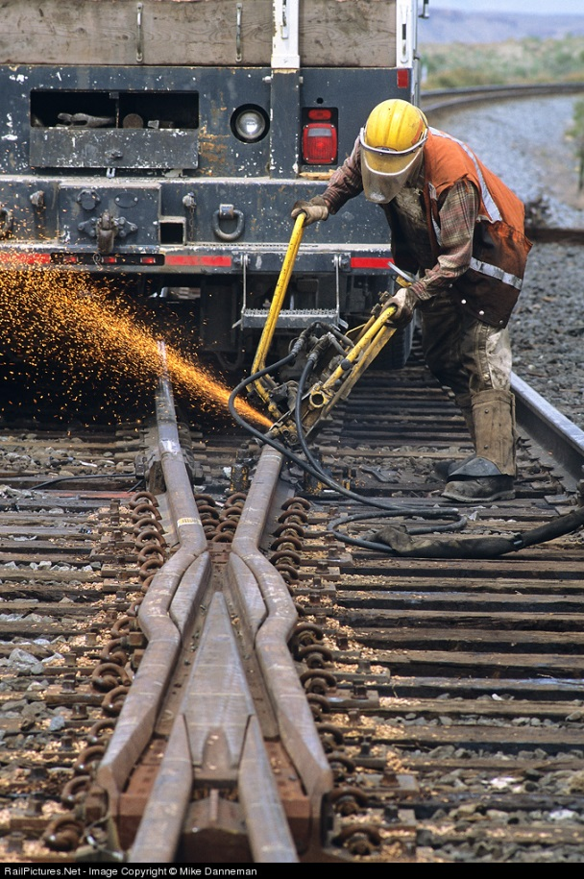
Questions?

