Slide 1
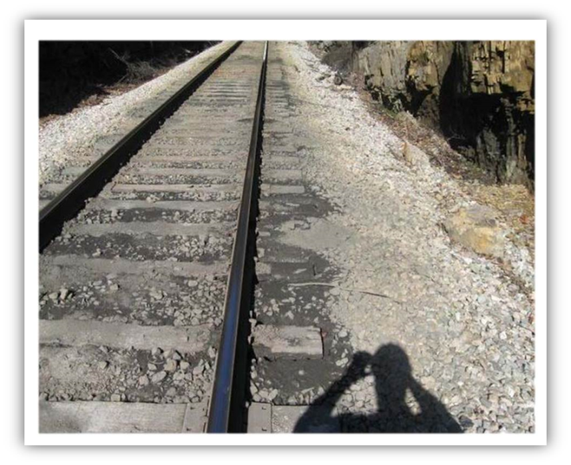

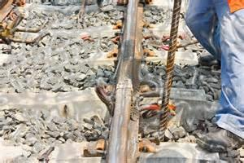
Track Standards Working Group Update to the
Railroad Safety Advisory Committee
September 15, 2016
Washington, DC

Slide 2
Track Standards Working Group (TSWG) Outline
Background
Recommendations
Task Statement and Status
TSWG Progress
Key Meeting Dates

Slide 3
TSWG TASK BACKGROUND
Part 213, Subpart A—General prescribes the designation and responsibility of qualified persons to supervise certain renewals and inspect track, Subpart F—Inspection prescribes the frequency and manner of inspecting track to detect deviations in Classes 1 through 5,
Track-caused derailments have occurred involving easily-detectable noncompliant track conditions, especially at higher track classifications,
Proper recognition and understanding of obvious isolated or combinations of track degradation conditions may well have prevented derailment occurrences,
Since the last rule change in 1998, the technology to identify emerging structural and geometry conditions has greatly improved, likewise, inspection recordkeeping technology has substantially evolved to document and maintain track inspection records electronically, substituting paper-based requirements, and needing regulatory revision or amendment

Slide 4
TSWG TASK STATEMENTS
RSAC Task 15-01 (Subpart F Inspection) and 15-02 (Track Geometry) initially presented to the RSAC in July 15, 2015 and accepted on July 31, 2015
RSAC Task 15-01 Purpose: To consider specific improvements to Part 213 Subpart F—Inspection of the Track Safety Standards or other responsive actions designed to enhance rail safety by reviewing track inspection methods, frequency, and documentation
Notes:
11/20 half day and 25/25 1 ½ days

Slide 5
CONSIDER RECOMMENDATIONS
NTSB—
  R-14-11 High Density commuter railroads exemption to traverse adjacent tracks, and
  R-14-76 Combination of track conditions
Fast Act (11409) Requirement—Commuter Rail Track Inspections (correlates to NTSB R-14-11)
Tourist and Historic Railroads and Private Passenger Cars Working Group—propose clarification to §238.3(a) schedule

Slide 6
NOVEMBER TSWG TASK PROGRESS
Initial November 20, 2015 Meeting,
  Identify top safety priorities
  Consider industry track inspection and maintenance ‘best practices’
  Create Task ‘checklist’ and e-library
  Develop electronic recordkeeping protocols (OMB)

Slide 7
FEBRUARY TSWG TASK PROGRESS
FRA provided an overview of:
  Economic Considerations
  Part 243 Training Rule
  Track Inspection Training
    Referencing Part 243 OJT to determine inspector proficiency
  Proposed FRA Safety Accomplishments and Objectives

Slide 8
JULY TSWG TASK PROGRESS
FRA defined its safety objectives, offered its track inspection findings, and proposed Part 213 regulatory language concerning:
      Subpart A—General
        § 213.5 Responsibility for Compliance—
          Good Faith Challenge
        § 213.7 Designation of Qualified Persons to Supervise Certain Renewals and Inspect Track—
        § 213.9 Classes of Track: operating speed limits—
        § 213.11 Restoration or renewal of track under traffic conditions

Slide 9
JULY TSWG TASK PROGRESS (cont.)
      Subpart F—Inspection
        § 213.233—Track Inspections, principally introducing automated inspection of High-hazard Flammable Trains routes and schedule frequency
        § 213.241—Inspection Records, and electronic record management
        § 213.242—Document and Record Accountability (new)
      BMWED provided a conceptual overview of proposed Part 213 Subpart A revisions

Slide 10
Task No. 15-01 Overall Status
TASK Elements | STATUS
Part 213 Subparts A and F requirements;
Previous studies of track inspections methods and other relevant information for manual and other methods to improve track inspection effectiveness, accuracy, and efficiency; | Completed
Review studies of electronic data collection, storage, and security; | Under review
Whether current track inspection methods and frequency remain effective and efficient, or need to be revised; | Under review
Whether electronic collection, storage and security of track inspection records should be revised; | Under review
Whether track inspector training should be formally developed and standardized, and whether that would modify the criteria and procedures for designation under Part 213 Subparts A and F | Under review
Notes:
Mentorship program to motivate and/or provide work experienced and develop internships for budding 213.7 personnel. Aspiring individual goals.
Evidence-driven.

Slide 11

TSWG MEETINGS
TRACK STANDARDS WORKING GROUP PROGRESS
Initial meeting November 20, 2015; February 24-25, 2016 and July 19-20, 2016
NEXT MEETING
December 6-7 2016
11
Notes:
Next meeting scheduled for end of July

Slide 12
Questions?

