Slide 1
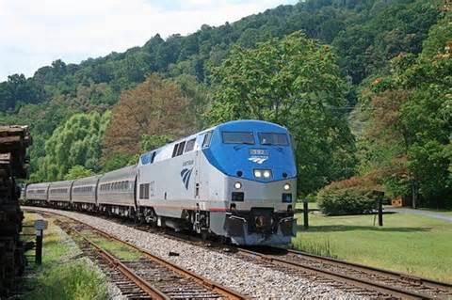

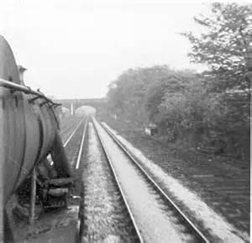
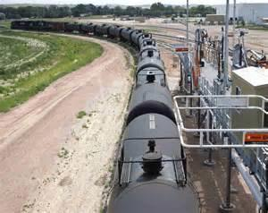
Office of Railroad Safety
Presentation
September 15, 2016

Slide 2
Agenda
Part 219 re-write and Addition of MoW
Review of current FRA/DOT D&A regulations
Review of recent data related to substance abuse – nationwide
Review of recent data related to substance abuse – rail industry specific
Review of the state of play on testing and employee assistance programs
Questions

Slide 3
Part 219 Rewrite and Addition of Maintenance-of-Way Effective Dates
Published Date: Friday, June 10, 2016
Effective Date: June 12, 2017
FRA-regulated D&A Program for MOW employees and all other new provisions for covered service employees begins June 12, 2017. Employers need to:
    Submit initial or amendment to FRA for MOW coverage in the random drug and alcohol plan and;
    Receive FRA approval of the plan in advance of the effective date;
    Notify and train employees on changes
Notes:
Random testing of MOW employees begin prior to June 12, 2017, if they submit a random drug and alcohol plan and receive FRA approval. All other provisions of the Final Rule are effective on June 12, 2017.

Slide 4
Significant Differences – NPRM vs. FR
The final rule contains two significant differences from FRA's July 28, 2014 Notice of Proposed Rulemaking (NPRM):
  Adopts part 214's definition of “roadway worker” to define “MOW employee” under this part.
  FRA has withdrawn its proposed peer support requirements, subpart K contains a revised version of the troubled employee identification requirements previously in subpart E.
Notes:
Previously there was a more limited definition of MOW

Slide 5
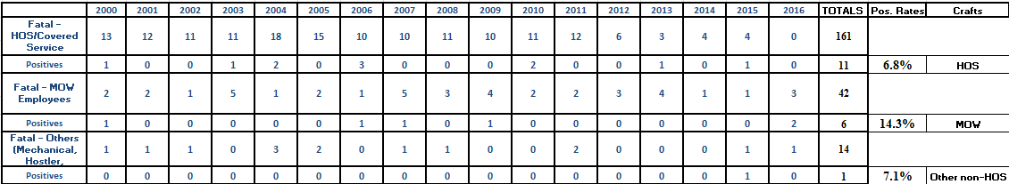
Summary of Changes
First major updating of Part 219 since its inception in 1985
Adds Maintenance-of-Way (MOW) employees.
The Retrospective Regulatory Review Amendments are essentially a re-write of Part 219 codifying the Compliance Manual (2002) and subsequent letters of interpretation.
FRA found a disproportionately high level of positive test results among deceased MOW employees compared to covered service employees.

Slide 6
“Regulated Employee” and Random Rates
Congress, in the Rail Safety Act of 2008 (RSIA), recognized the substance abuse problem among MOW employees by directing FRA to make them fully subject to the policies and protections of part 219. FRA will introduce MOW employees to random drug and alcohol testing at the same initial minimum random testing rates it initially applied to covered service employees – 50% annual minimum for drugs; 25% for alcohol.
A railroad must therefore create and maintain a separate random testing pool for its MOW employees to allow these employees to be tested at their own minimum random testing rates.
FRA is also adding a new definition, “regulated employee,” to encompass both HOS/covered service and MOW employees.

Slide 7
Adding “Regulated Employee”
Part 219 will be applicable to those employees who directly perform MOW activities for them, but also the roles and responsibilities of contractors and subcontractors who provide MOW services to railroads.
As has been its practice, FRA is holding railroads, contractors, and subcontractors equally responsible for ensuring that their employees who perform MOW activities are in compliance with the requirements of this rule.
Notes:
Railroads will be responsible for monitoring contractor programs and contractors are required to submit bi-annual D&A MIS reports

Slide 8
Partial Compliance - Small Railroad Exception
Previously, a small or partial compliance railroad only needed to perform post-accident testing in Subpart C qualifying accidents.
The new part 219.3(c) Small railroad exception now excludes only Subparts E (reasonable cause) and G (random) and a small railroad may not perform Federal alcohol and drug testing authorized by these subparts. A small railroad remains a railroad that:
Has a total of 15 or fewer employees who are covered by the hours of service laws (MOW is not HOS-does not count), and
Does not have joint operations, as defined in § 219.5, with another railroad that operates in the United States, except as necessary for purposes of interchange.
A MOW contractor that works exclusively for small railroads also qualifies for the small railroad exception (i.e., is excepted from the requirements of subparts E and G of this part). A contractor is not excepted if it performs MOW activities for at least one full compliance railroad.
Notes:
See new definition of Joint Operations. Small railroads will now be required to conduct DOT pre-employment and DOT reasonable suspicion testing beginning June 12, 2017. All regulated service employees hired before that date will be grandfathered for DOT pre-employment testing. Small Railroads will still not be allowed to perform DOT random or reasonable cause testing.

Slide 9
New Definitions
In general, there are three new categories of definitions:
Definitions in other FRA rules applicable to Part 219 that have developed since the original Part 219 came into effect in the late 80’s
Definitions in other FRA rules now applicable to Part 219 since MOW has been added as a regulated service
Definitions of elements of the original Part 219 that were refined through later interpretation.
Notes:
Defined the definition due to railroads in the past not considering “Probationary employees” as an employee having rights to 219.104 (c) hearing.

Slide 10
Definitions in other FRA rules applicable to Part 219 that have developed since the original Part 219 came into effect
Examples:
  Drug and Alcohol Counselor or DAC - FRA is adopting this part's definition for “Drug and Alcohol Counselor” or “DAC” from § 242.7 of its conductor certification rule. DAC replaces EAP and “substance abuse professional” in current Part 219.
  DOT Safety-Sensitive Duty or DOT Safety-Sensitive Function - The performance of a “DOT safety-sensitive duty” or “DOT safety-sensitive function” makes a person subject to the drug testing and/or alcohol testing requirements of a DOT agency from Part 40.3 employee definition. The performance of regulated service (MOW) is a DOT safety-sensitive duty or function under this part.
  Highway-Rail Grade Crossing - FRA is adopting the definition of “highway-rail grade crossing” found in § 225.5 of its accident and incident reporting regulation, which includes all crossing locations within industry and rail yards, ports, and dock areas.

Slide 11
Definitions in other FRA rules applicable to Part 219 now that MOW has been added as a regulated service
Examples:
Flagman or Flagger - FRA is adopting its proposal to define a “flagman” (also known as a “flagger”) and “watchman/lookout” in § 219.5 as those terms are currently defined in § 214.7
On-Track or Fouling Equipment - This new definition includes any railroad equipment positioned on or over the rails or fouling a track.
Other Impact Accident - An “other impact accident” includes any accident/incident involving contact between on-track or fouling equipment that is not otherwise classified as another type of collision (e.g., a head-on collision, rear-end collision, side collision, raking collision, or derailment collision). This new definition also includes an impact in which a single car or cut of cars is damaged during operations involving switching, train makeup, setting out, etc.
Watchman/Lookout - This definition is identical to that in § 214.7, subpart C of part 214, roadway worker protection.

Slide 12
Definitions of elements of the original Part 219 that were refined through later interpretation.
Examples:
Employee - An “employee” is any person, including a volunteer, and a probationary employee, who performs activities for a railroad or a contractor to a railroad.
Evacuation - Under § 219.201(a)(1)(ii)(A), one of the criteria for a “major train accident” requiring PAT testing is an evacuation. To qualify as an evacuation, an event must involve the relocation of at least one person (not a railroad employee) to a safe area to avoid exposure to a HazMat release; ordered by local authorities (mandatory or voluntary). This definition does not include simply the closure of public roadways for HazMat spill containment, unless that closure was accompanied by an evacuation order.
Raking Collision - As newly defined, a “raking collision” occurs when there is a collision between parts, with the lading of a train on an adjacent track, or with a structure such as a bridge. A collision that occurs at a turnout is not a raking collision
Railroad Property Damage or Damage to Railroad Property - As proposed, the amended definition of “railroad property damage or damage to railroad property” means damage to railroad property, including damage to on-track equipment, signals, track, track structure, or roadbed; and labor costs, including hourly wages, transportation costs, and hotel expenses; but excluding damage to lading and the cost of clearing a wreck; except that the cost of contractor services, of renting and operating machinery, and of any additional damage caused while clearing the wreck
Notes:
Emphasis: A collision that occurs at a turnout is not a raking collision. Railroads were using this as reason not to test.

Slide 13
Pre-employment Drug Testing of Contractor MOW Employees
Each railroad must ensure that each employee of a contractor who performs regulated service on the railroad's behalf has a negative DOT pre-employment drug test on file with his or her employer.
A contractor employee who performs regulated service for more than one railroad does not need to have a DOT pre-employment drug test for each railroad for which he or she provides service.
No pre-employment testing required for regulated employees of railroads qualifying for the small railroad exception (see § 219.3(c)) or maintenance-of-way employees who were performing duties for a railroad - both before June 12, 2017.
However, newly hired MOW employees must be tested after June 12, 2017 and grandfathered employees must have a negative pre-employment drug test if they go to a new railroad after June 12, 2017.

Slide 14
MOW Employee Minimum Random Testing Pool Size
As proposed, to maintain the deterrent effect of random testing for very small railroads and contractors, FRA is requiring each individual random testing pool established under subpart G to select and randomly test at least one entry per quarter, even if fewer tests are needed to meet FRA's minimum random testing rates.
Conversely, the requirement to conduct at least four tests throughout the year does not excuse a railroad (or contractor to a railroad, or a C/TPA) from complying with FRA's minimum random testing rates. For example, a railroad that maintains a pool of 16 MOW employees must conduct at least eight, not four, random drug tests in a year to comply with a minimum random drug testing rate of 50%.

Slide 15
Division of Reasonable Suspicion and Reasonable Cause Testing into Subparts D and E
Previously, the requirements for both reasonable suspicion and reasonable cause testing were found in subpart D. Because of their similar names and their location in the same subpart, railroads and employees often confused the two types of testing, even though reasonable suspicion and reasonable cause testing have very different requirements.
To clarify the substantive differences between the two, the requirements for reasonable suspicion testing will remain in subpart D, while the requirements for reasonable cause testing have been moved to subpart E.
Notes:
Smaller Railroads will now be required to conduct reasonable suspicion testing.

Slide 16
Transfer of Revised and Retitled Troubled Employee Requirements to Subpart K
To accommodate the placement of reasonable cause testing into subpart E, FRA has transferred a revised and retitled version of the “Identification of Troubled Employees” requirements previously in subpart E to new subpart K. (As noted above, this is in lieu of FRA's proposal to require peer support programs in subpart K, which, for the reasons discussed below, FRA is not adopting).

Slide 17
Exclusions to Grade Crossing Accident Testing Exception
Previously, part 219.201(b) had an exclusion for post-accident testing in all collisions at grade crossing. In response to NTSB recommendation R-01-17, Part 219.201(a)(5) requires PAT testing after a highway-rail grade crossing accident/incident whenever there is the following:
Reason to believe that a regulated employee has interfered with the normal functioning of a grade crossing signal system without first providing for the safety of highway traffic.
Event involving violations of the flagging duties found in FRA’s grade crossing regulation.
Event involving violation of an FRA regulation or railroad operating rule by a regulated employee that may have played a role in the cause or severity of the accident/incident.

Slide 18
Rule G Checks
New rule requires two per year per regulated employee
  219.105(d) Each year, railroad's supervisors must conduct and record a number of “Rule G” employee observations at a minimum equal to twice the railroad's total number of regulated employees. Each “Rule G” observation must be made sufficiently close to an individual regulated employee to determine whether the employee is displaying signs and symptoms indicative of a violation of the prohibitions of this part.
Compliance Manual called for four per year per covered employee as guidance

Slide 19
Recall for Post-accident Testing
As proposed, FRA eliminated its previous requirement that a qualifying PAT event had to have occurred during the employee's duty tour.
FRA has simplified its employee recall provisions by requiring a regulated employee to be immediately recalled and placed on duty for PAT testing if only two conditions are met:
  The railroad could not retain the employee in duty status because the employee went off duty under normal carrier procedures before the railroad instructed the employee to remain on duty pending its testing determination; and
  the railroad's preliminary investigation indicates a clear probability that the employee played a role in the cause or severity of the accident/incident.

Slide 20
Exceeding Hours-of-Service
A railroad is not excused from performing alcohol or drug testing under subpart C (post-accident toxicological testing) and subpart D (reasonable suspicion testing) of this part because the performance of such testing would violate the hours-of-service laws.
A railroad may perform alcohol or drug testing authorized under subpart E (reasonable cause testing) of this part even if the performance of such testing would violate the hours-of-service laws. FRA will not take enforcement action for the violation if the railroad used reasonable due diligence in completing the collection, although the railroad must still report any excess service to FRA.
A railroad must schedule random alcohol and drug tests under subpart G of this part so that sufficient time is provided to complete the test within a covered employee's hours-of-service limitations. Excuse if normal collection exceeds HOS. However, if a direct observation collection is required during a random test per the requirements of part 40 of this title, then the random test must be completed regardless of the hours-of-service law limitations, although the railroad must still report any excess service to FRA.

Slide 21
Reasonable Cause
Employer was authorized to perform reasonable cause testing (DOT or company) if an event met the Part 219.301 criteria.
Now employer must perform all testing either DOT or Company – cannot mix and match.

Slide 22
FRA HQ Contacts
Please Call or email with any Questions
Jerry Powers, Drug & Alcohol Program Manager – Washington, DC
Sam Noe, Drug & Alcohol
Program Specialist – Nashville, TN
Sandra Volante, Drug & Alcohol
Program Analyst – Cambridge, MA
George Ellis – Oversight Contractor
Elizabeth Gross – Attorney
Patricia Sun – Attorney
202-493-6313
Gerald.Powers@dot.gov
615-719-2951
Sam.Noe@dot.gov
682-351-3428
Sandra.Volante@dot.gov

Slide 23
Questions

Slide 24
D&A Regulations
DOT testing conforms with HHS federal testing 5-panel for the following substances:
    1) Marijuana, 2) Cocaine, 3) Opiates, 4) Amphetamines, 5) PCP
    What the HHS-DOT 5-panel does NOT test for:
    Synthetic opioid painkillers (such as Fentanyl, Vicodin, Percocet, OxyContin, Dilaudid)
    Tranquilizers (e.g. Valium, Xanax, Ativan)
    Muscle relaxers (e.g. Flexeril), barbiturates, synthetic marijuana (K2, Spice) …
FRA testing employs the 5-panel for all the following test types:
    Pre-employment
    Random
    Reasonable Suspicion
    Reasonable Cause (post accident – FRA custom panel)
    Post-violation: Return-to-Duty and Follow-up
FRA post-accident testing employs expanded panel (both blood and urine tests) - accidents of $1M or more property damage, $150K or in impacts, fatality, or passenger injury
Some Railroads use company testing including:
    Hair testing (90-day detection window) for pre-employment
    Expanded 10-panel testing plus synthetic marijuana
Notes:
FRA uses its own custom expanded testing panel and program for Post-accident testing for accidents of $1M or more property damage, $150K or in impacts, fatality, or passenger injury
Pre-dated the overall DOT testing statute and regulations
Blood draw in addition to urine collection

Slide 25
D&A regulations
Self Referral programs – can make a difference
The FRA D&A testing program covers the following hours-of service (HOS) safety-sensitive crafts:
    Train & Engine
    Dispatch
    Signal
    Carmen/Hostlers
Recently published final rule adding the first non-HOS safety-sensitive craft:
    Maintenance-of-Way/Roadway Workers
    Implementation date: June 12, 2017
One safety-sensitive craft remains:
  Mechanical
    Only ~30% of Mechanical employees are randomly tested currently
    The other 70% do not have the deterrent effect of any random testing program
    Show significantly higher violation rates than covered service employees; 33% positive rate in post-accident over the last 13 years

Slide 26
Recent Drug Incidents
  Fall 2014 – Employee discovered in the work parking lot – fatal opiate overdose which included heroin, oxycodone, oxymorphone, and fentanyl
  Spring 2015 – Employee fatally injured in a yard incident - FRA post-accident test was positive for marijuana
  Winter 2016 – MOW employee – fatal fentanyl (opiate) overdose at work site, after start of shift, following job briefing
  Spring 2016 – SIX post-accident positives in THREE separate accidents within a month
  Summer 2016 – Two separate accidents, with train crew positive for marijuana
Notes:
Make brief

Slide 27
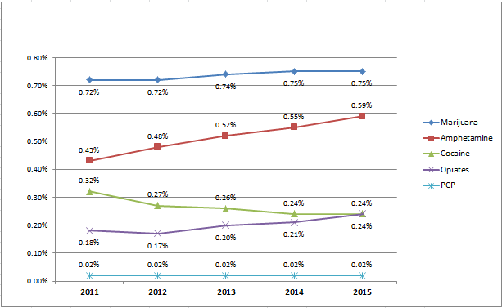
Review Data Related to Substance Abuse – Nationwide
All DOT Agencies - Laboratory Chemical Positives
Marijuana trending up slowly; amphetamines and opiates (organic) trending up long term
Lab Reported DOT Testing Data – last 5 years
Opiates equal Cocaine
Notes:
We’re seeing marijuana positive rise with the permissiveness in marijuana states

Slide 28

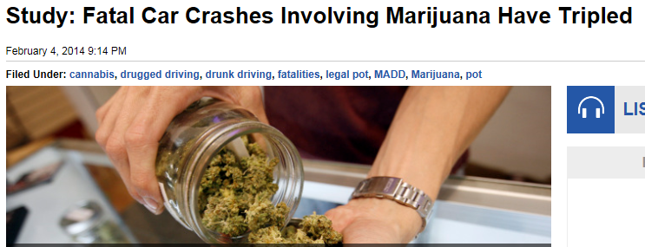
State Laws
Colorado marijuana-related traffic fatalities up 32%
NHTSA found that 4% of drivers were high during the day and more than 6% at night, and that nighttime figure more than doubled to 12% on weekends.

Slide 29
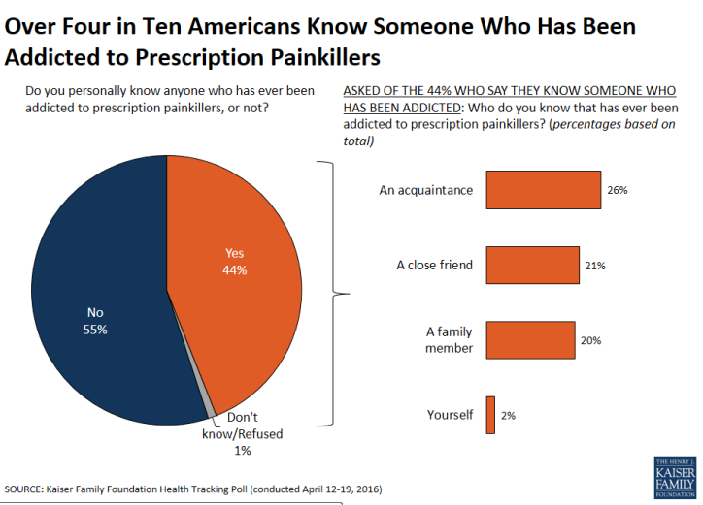
The Prescription Opioid Epidemic

Slide 30
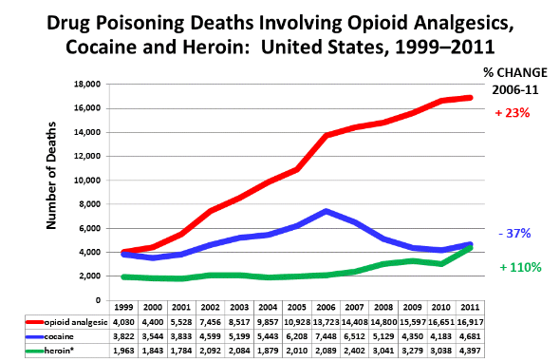
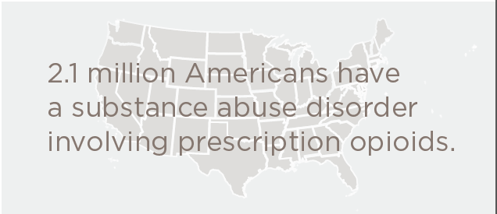
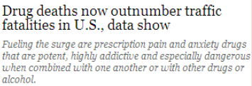
Prescription Opioid Epidemic
FRA DOT testing (except FRA post-accident) conforms to Health and Human Services (HHS) Federal 5-panel testing
HHS 5-panel does NOT include synthetic opioid painkillers
Addition of opioids and oral fluids - final rule
at HHS
CDC Data

Slide 31
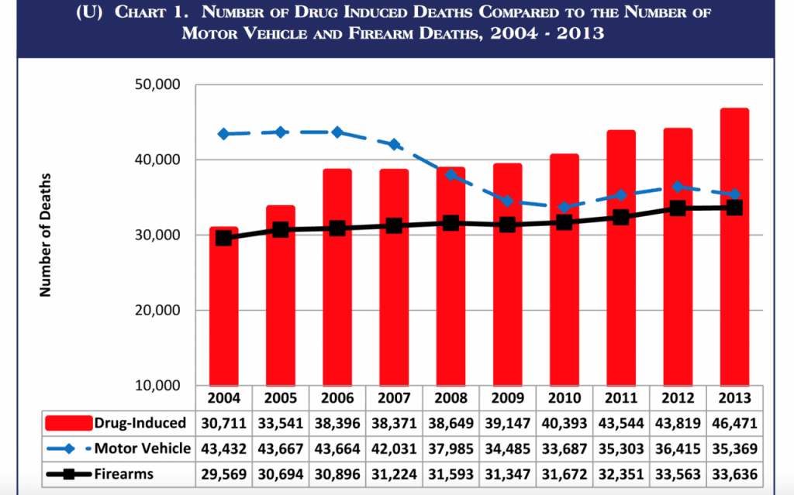
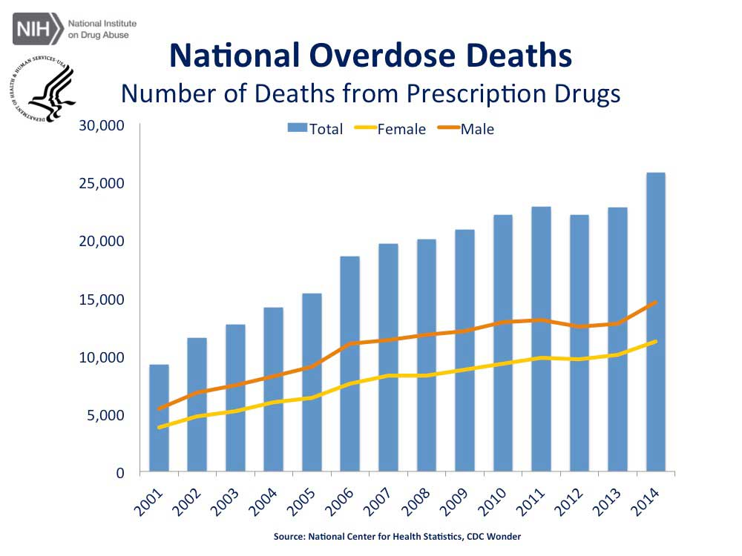
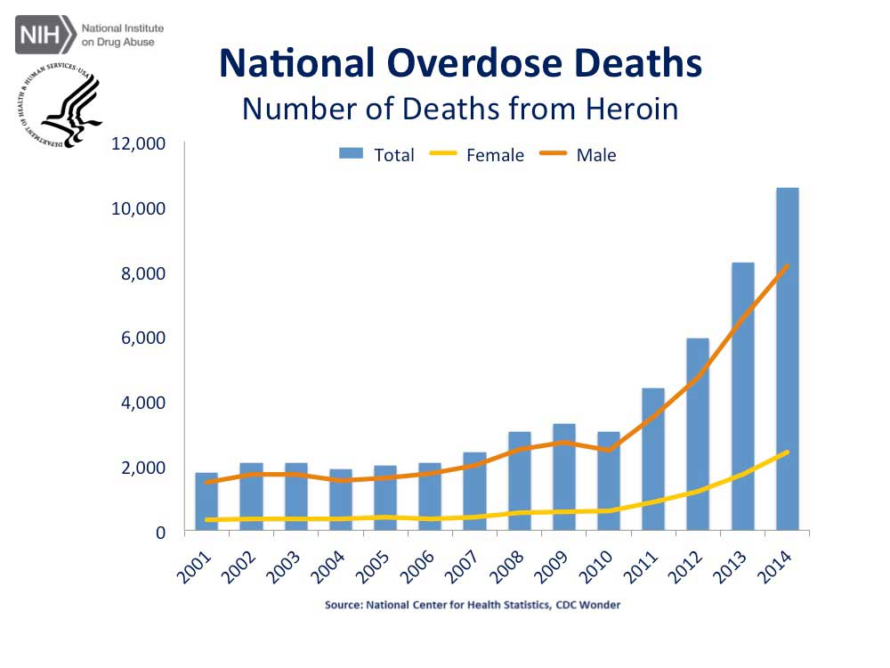
Overall Threat Assessment:
Prescription Meds – The New Drugs of Abuse
(Double click)
Notes:
NTSB – Calvin’s time lapse chart

Slide 32
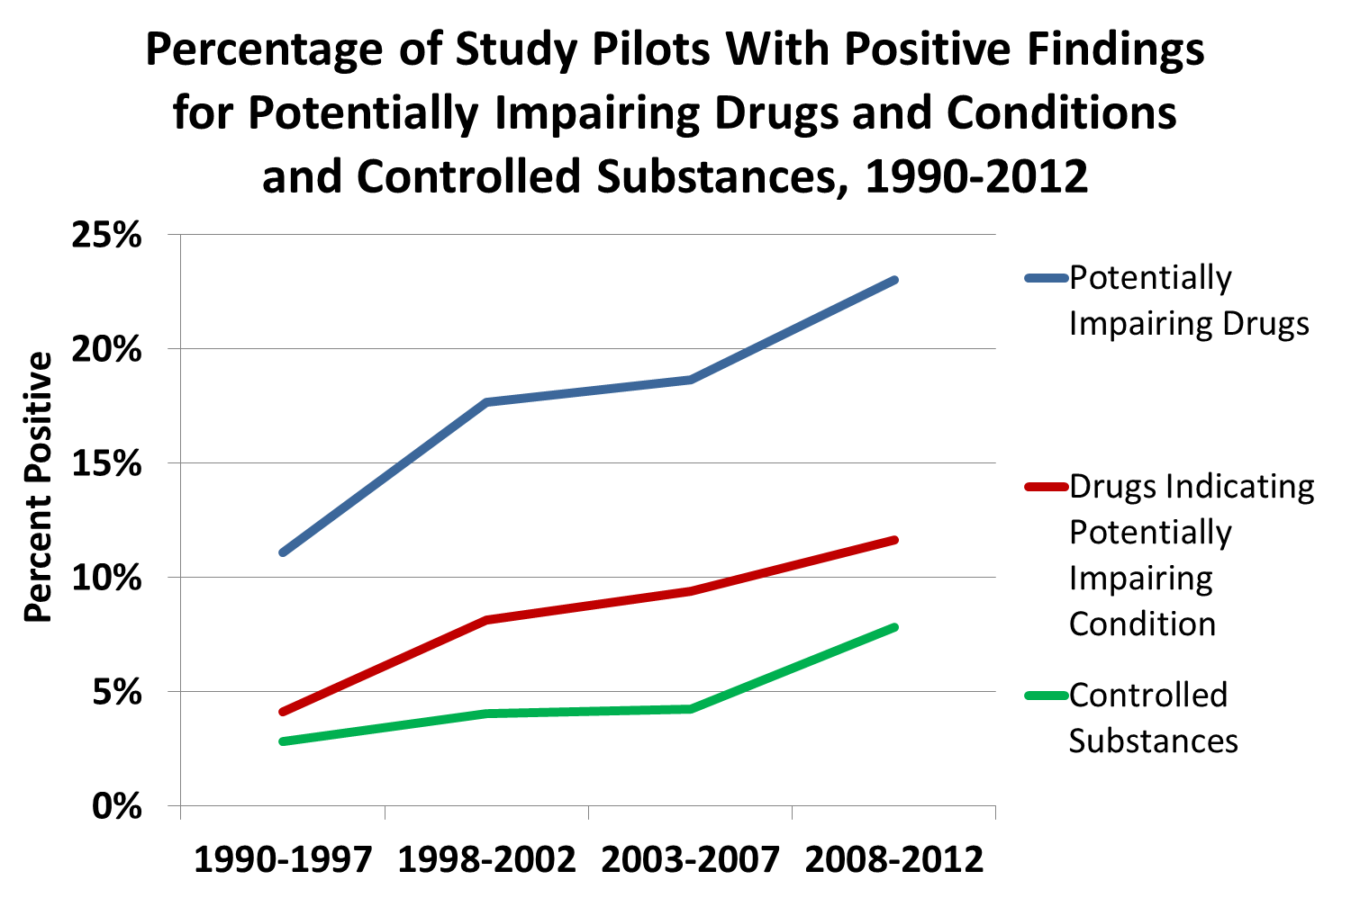
Percentage of Aviation Pilots with Positive Findings
for Potentially Impairing Drugs, Impairing Conditions, and Controlled Substances 1990-2012
Notes:
NTSB

Slide 33
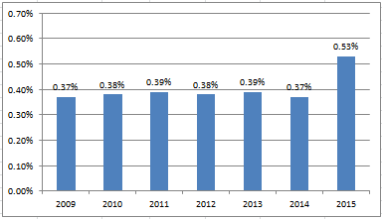
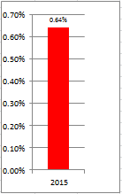
Review of recent rail industry data related to substance abuse
FRA Random Drug Positive Rate 2009-2015
FRA random drug testing violation rate jumped significantly in 2015 (for covered service employees) – up over 43% in 2015 from the steady rates from the previous five years (represents ~50,000 tests annually)
In addition, 2016 random alcohol testing in the mechanical craft is running over five times higher than covered service rate (0.81% vs. 0.14%)
2015 Mechanical

Slide 34
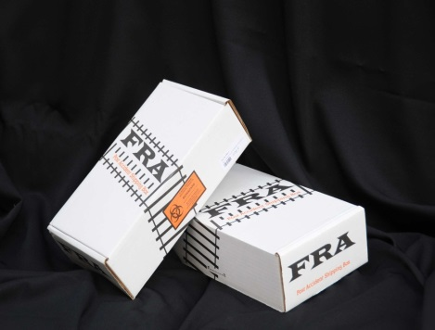
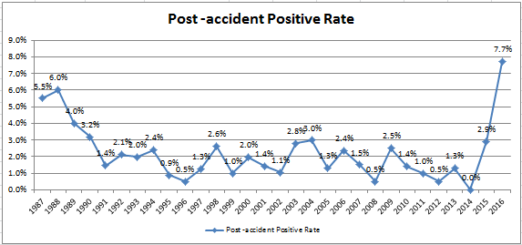
Post-accident Testing Chart 1987-2016
Expanded panel casts the net much wider than random
So far in 2016 – our highest positive rate ever
Non-covered positive rates are much higher – since 2003: Mechanical at 33% and MOW at 14%
3 Marijuana
4 Cocaine
1 Ecstasy (a first)
1 Benzo (no Rx)
1 Oxy
1 Morphine
3 Marijuana
1 Codeine (no Rx)
+8 Downgrades
Notes:
Again, we test for an expanded panel (cast the net wider). Post-accident is also more random than random.

Slide 35
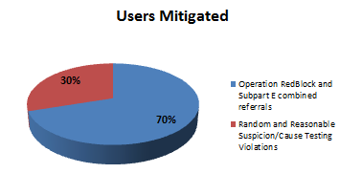
State of play on employee assistance (EAP) and Peer-to-peer Programs
Employee Assistance Programs can be a “Force-multiplier” to the FRA testing program
  Yields huge benefits when marketed properly – RRs will detect more problems through EAPs than via testing along
  Example: several Class I railroads have over 2 ½ times EAP referrals for substance abuse than D&A testing violations in recent years.
If a railroad is not seeing 2 to 3 times the
voluntary/peer EAP referrals than D&A test
violations then the program may not be
working properly

Slide 36
Questions

